Slide 1
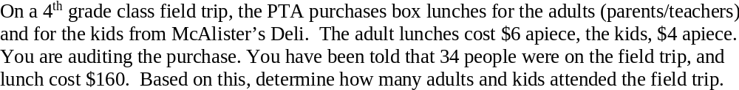

Slide 2
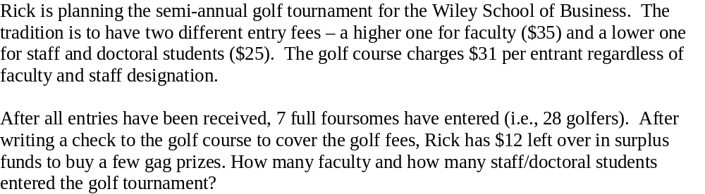
Decisions: F = faculty, S= staff.
The golf cost 28 x 31 = 868. Rick collected 868+12=880
35F + 25S = 880. (Equation 1)
F + S = 28 (Equation 2)
Take EQ. 2 and make it: S = 28 – F. Substitute into Eq. 1.
35F + 25(28-F) = 880. 10F = 180 ->> F = 18 ->> S = 10.

Slide 3
Decisions: R = Rick, C= Cassie. Age today.
R = C +25 (25 years older).
Six years ago: ½ (R-6) = (C-6)
This becomes: R – 6 = 2C – 12 -> R = 2C – 6.
Substitute into first equation: 2C – 6 = C + 25. -> C = 31, R = 56.

Slide 4
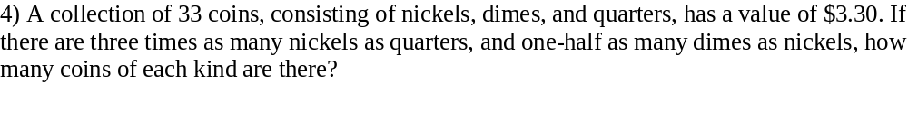
Decisions: N, D, Q. There are actually 4 ‘constraints’ here.
N + D + Q = 33.
5N + 10D + 25Q = 330 (value)
N = 3Q and D = 1/2N (ratios and yes, they are the right ‘direction’).
We can find the number of N by using the first equation and both ratios: N + 1/2N + 1/3N = 33. 11/6 N = 33 -> N = 18.
Then, substitute back into the ratios. Q = 6, D = 9. We never used the value! But we can validate our solution.
5 x 18 + 10 x9 + 25 x 6 = 90 + 90 + 150 = 330!!!! (q.e.d)- that’s some Latin phrase ☺.

